Slide 1



What is new in PowerShell 5.x for the IT Pro
As much as I can cover in 45 minutes
Name : Ben Gelens
Job : Consultant
MVP : CDM (PowerShell)
Company : inovativ
Email : ben@bgelens.nl
Twitter : @bgelens
Community : {Hyper-V.nu, azurestack.eu, DuPSUG}
Blogging : {Hyper-V.nu, PowerShellMagazine.com, azurestack.eu}
Notes:
45 Minutes + 5 Minutes Q&A

Slide 2
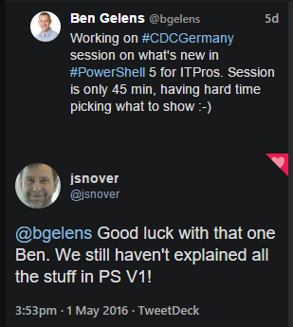



Slide 3
Agenda
Availability
What is new? (Overview)
Demo
Windows Server 2016 / Windows 10 / Nano
Demo
Notes:
Who doesn’t know about PowerShell?

Slide 4
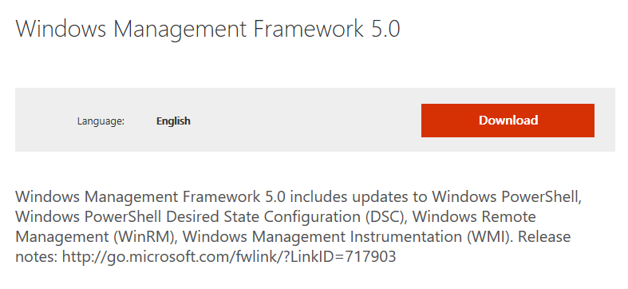
Availability
Part of Windows Server 2016 / Windows 10
Continuously updated
Part of WMF 5.x
Down-level support for 2008R2 / Windows 7+
Support for WMF 5.0 for critical security issues for 4 months after WMF 5.1 is released

Slide 5
What is new?
PowerShell Classes and Enums
A lot of DSC improvements! (encrypted MOFs, partial configs, Class resource, etc)
Copy over PSSession
System-wide Transcript
Script Block logging
CMS encryption cmdlets
Advanced debugging
Clipboard cmdlets
Recycle bin cmdlet
Temporary file cmdlet
Archive cmdlets (Open-Sourced! https://github.com/PowerShell/Microsoft.PowerShell.Archive) (down-level release PS4)
Guid cmdlet
JEA
PackageManagement / PowerShellGet (Module, script and software discovery / install / inventory) (down-level release PS3+)
Information stream
Generate Odata endpoint cmdlets
Network switch management
Remote edit file / script
Local user / group management (5.1)
Module signing (5.1)
…
Notes:
Too much to handle in 45 mins.

Slide 6
Demo!
Notes:
I can talk for hours but Examples tell a better story ☺
Demo: Copy over PSSession (including remote edit)
Demo: Archive
Demo: PackageManagement / PowerShellGet
Demo: LCM encryption of MOFs
Demo: Script block logging / transcript

Slide 7
Windows Server 2016 / Windows 10
PowerShell Direct
Copy-Item
Enter-PSSession
Invoke-Command
PNP Device management
Shipped OSS modules PSReadLine and Pester
…

Slide 8
Demo!
Notes:
I can talk for hours but Examples tell a better story ☺
Demo: PowerShell direct (bugged on my machine)
Demo: Device management
Demo: Local User Management

